Slide 1
Introduction
.NET Framework

Slide 2
.NET – परिचय
.NET एक software framework है जिसे माइक्रोसॉफ्ट द्वारा बनाया गया है.
इसका पहला संस्करण (version) 1.0 था जो वर्ष 2002 में आया |
यह एक virtual machine है जो विभिन्न भाषाओ में लिखे गए प्रोग्राम को compile (संकलित) तथा execute (कार्यान्वित) करता है | जैसे – C#, VB.Net आदि |
इसका उपयोग कंसोल एप्लीकेशन, फॉर्म-आधारित एप्लीकेशन (form based applications), वेब-एप्लीकेशन तथा वेब सर्विसेज को विकसित करने में होता है |
डॉट-नेट 60 प्रोग्रामिंग भाषों का समर्थन करता है जिसमें 11 भाषाएँ ऐसी है जो माइक्रोसॉफ्ट द्वारा विकसित की गई है |

Slide 3
माइक्रोसॉफ्ट द्वारा विकसित 11 प्रोग्रामिंग भाषाएँ
C# .NET
VB.NET
C++ . NET
J# .NET
F# .NET
JSCRIPT .NET
WINDOWS POWERSHELL
IRON RUBY
IRON PYTHON
C OMEGA
ASML (Abstract State Machine Language)

Slide 4
Framework - रुपरेखा / संरचना
पूर्व निर्धारित फ्रेम/संरचना प्रदान करता है जिसमे प्रोग्रामर काम करेगा |
एप्लीकेशन डिजाईन के लिए स्ट्रक्चर प्रदान करता है
एप्लीकेशन विकसित करने में सहायक होता है |
एप्लीकेशन बनाने के लिए आवश्यक टूल्स (ASP .Net, Silverlight, MVC) प्रदान करता है
इसकी अपनी कुछ सीमाएं (limitations) होती है |
इसकी सहायता से कई प्रकार के एप्लीकेशन का निर्माण किया जा सकता है – कंसोल (console) एप्लीकेशन, विंडोज एप्लीकेशन, वेब एप्लीकेशन, मोबाइल एप्लीकेशन, वेब सर्विस, WCF सर्विस, वेब API, स्वनिर्मित लाइब्रेरी इत्यादि |

Slide 5
डॉट नेट फ्रेमवर्क = library (FCL) + runtime environment (CLR)
FCL – Framework Class Library – पूर्व-निर्मित प्रोग्राम/फंक्शन का समूह जो सॉफ्टवेर एप्लीकेशन बनाने में सहायक होते है | जैसे – यूजर इंटरफ़ेस, डेटाबेस कनेक्टिविटी, क्रिप्टोग्राफी, वेब डेवलपमेंट और भी कई | reusable
CLR – Common Language Runtime – यह प्रोग्राम / एप्लीकेशन के क्रियान्वयन (Execution) में सहायक होता है | इसका अर्थ है की डॉट नेट फ्रेमवर्क कई भाषाओँ का समर्थन करता है और CLR उनको स्वतः क्रियान्वित करता है | जैसे – C#, VB .NET, ASP .Net, C++, Python, C etc.
.Net framework language interoprability (विभिन्न भाषाओँ की परस्पर-संक्रियता) प्रदान करता है |

Slide 6
डॉट नेट संस्करण - .Net Versions
Version | CLR | Release Date | IDE | Windows Support
1.0 | 1.0 | 13 Feb. 2002 | VS .NET | XP SP1
1.1 | 1.1 | 24 Apr 2003 | VS.NET 2003 | XP SP2, SP3
2.0 | 2.0 | 07 Nov 2005 | VS 2005 | N/A
3.0 | 2.0 | 06 Nov 2006 | Expression Blend | Windows Vista
3.5 | 2.0 | 19 Nov 2007 | VS 2008 | Windows 7, 8, 8.1, 10
4.0 | 4.0 | 12 Apr 2010 | VS 2010 | N/A
4.5 | 4.0 | 15 Aug 2012 | VS 2012 | Windows 8
4.5.1 | 4.0 | 20 Aug 2015 | VS 2013 | 8.1
4.5.2 | 4.0 |  | NA | NA
4.6 | 4.0 |  | VS 2015 | 10 v 1507
4.6.1 | 4.0 |  | VS 205 UPDATE 1 | 10 V 1511
4.6.2 | 4.0 |  | NA | 10V1607
4.7 | 4.0 |  | VS 2017 | 10 V 1703
4.7.1 | 4.0 |  | VS 2017 | 10 V 1709
4.7.2 | 4.0 |  | VS 2017 | 10 V 1803

Slide 7
.NET Framework 4.8 (सबसे नवीन संस्करण – latest version)
Visual Studio 2019 – Coomunity Edition
All the new versions are compatible with previous versions, this is called backward compatibility. नया संस्करण हमेशा पुराने संस्करण को सपोर्ट करता है |
पूर्व में .NET Framework OS के साथ ही आता था परन्तु अब Windows 8 के बाद से इसे पृथक्क रूप से install करना पड़ता है |

Slide 8
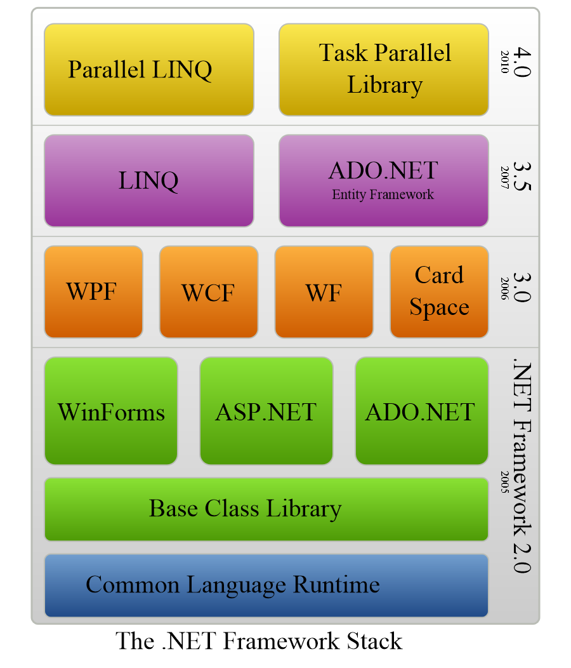
.NET Framework Stack (क्रमबद्ध जमाव)

Slide 9
Components of .NET Framwork डॉट-नेट फ्रेमवर्क के अवयव
Common Language Runtime or CLR
इसके विभिन्न कार्य निम्नानुसार है -
Memory management, exception handling, debugging, security checking, thread execution, code execution, code safety, verification and compilation.
Managed Code – Code directly managed by CLR
Managed code is compiled into CPU independent Intermediate Language (IL). Just In Time (JIT) compiler compiles the IL into native code, which is CPU specific.
2. Framework Class Library (FCL)– library of reusable types, classes, interfaces, structures and enumerated values , collectively called types.
3. Common Language Specification (CLS)– all language specification and language integration

Slide 10
(4) Common Type System (CTS) It provides guidelines for declaring, using, and managing types at runtime, and cross-language communication.
(5) Metadata and Assemblies Metadata is the binary information describing the program, which is either stored in a portable executable file (PE) or in the memory. Assembly is a logical unit consisting of the assembly manifest, type metadata, IL code, and a set of resources like image files.
(6) Windows Forms Windows Forms contain the graphical representation of any window displayed in the application.

Slide 11
(7) ASP.NET and ASP.NET AJAX ASP.NET is the web development model and AJAX is an extension of ASP.NET for developing and implementing AJAX functionality. ASP.NET AJAX contains the components that allow the developer to update data on a website without a complete reload of the page.
(8) ADO.NET It is the technology used for working with data and databases. It provides access to data sources like SQL server, OLE DB, XML etc. The ADO.NET allows connection to data sources for retrieving, manipulating, and updating data.
(9) Windows Workflow Foundation (WF) It helps in building workflow-based applications in Windows. It contains activities, workflow runtime, workflow designer, and a rules engine.

Slide 12
(10) Windows Presentation Foundation It provides a separation between the user interface and the business logic. It helps in developing visually stunning interfaces using documents, media, two and three dimensional graphics, animations, and more.
(11) Windows Communication Foundation (WCF) It is the technology used for building and executing connected systems.
(12) Windows CardSpace It provides safety for accessing resources and sharing personal information on the internet.
(13) LINQ It imparts data querying capabilities to .Net languages using a syntax which is similar to the tradition query language SQL.

Slide 13
Is .NET framework platform in-depnedent or dependent ?
A .NET application is platform dependent because of the .NET framework which is only able to run on the Windows-based operating system.
The .Net application is platform independent also because of Mono framework. Using Mono framework the .Net application can run on any Operating System including windows. Mono framework is a third party software developed by Novell Company which is now a part of Micro Focus Company. It is a paid framework.

Slide 14
.NET Framework advantages/features
Object Oriented Programming
Language Independence
Efficient data access
Code Sharing (reusability)
Support for services (Web Services, WCF, RESTful services)
Framework Class Library (reusable code)
Security
Interoperability
Common Language Runtime
Portability
Simplified Deployment

Slide 15
Compilation Process (संकलन प्रक्रिया)
संकलन प्रक्रिया दो चरणों (Phase) में पूर्ण होती है –
पहला चरण – (First Phase) Language Compiler
दूसरा चरण – JIT (Just In Time Compiler)

Slide 16
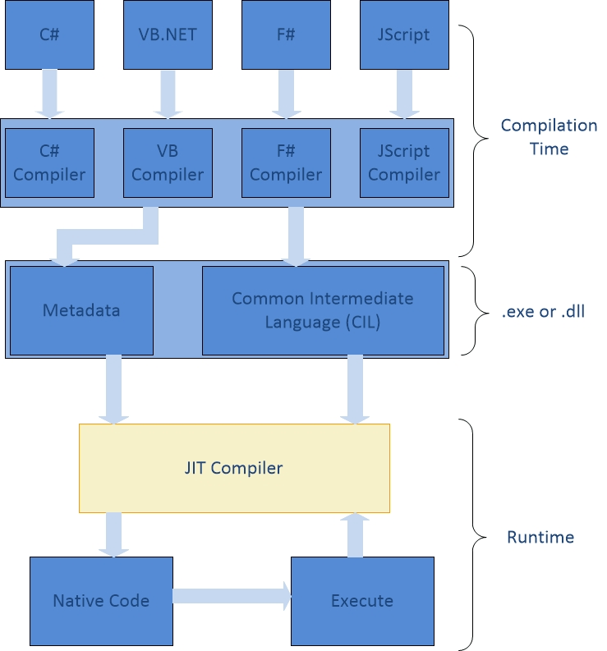
Compilation Process -
dll – Dynamic Link Library
MSIL – Microsoft Intermediate Language
CLR – Common Language Runtime

Slide 17
Program Compilation
csc.exe - C # Compiler
vbc.exe – VB Compiler

Slide 18
Microsoft Visual Studio .Net
यह Micerosoft द्वारा विकसित एक IDE (Integrated Development Environment) है जो की .Net applications को बनाने, सम्पादित करने तथा debug करने में सहायक है |
यह एक tool है जो की businees-critical तथा mission-critical applications बनाने में प्रयुक्त होता है |
इसमें हम visual programming भी कर सकते है अर्थात पूर्व-निर्मित GUI components को drag-and-drop करके application बनाना |

Slide 19
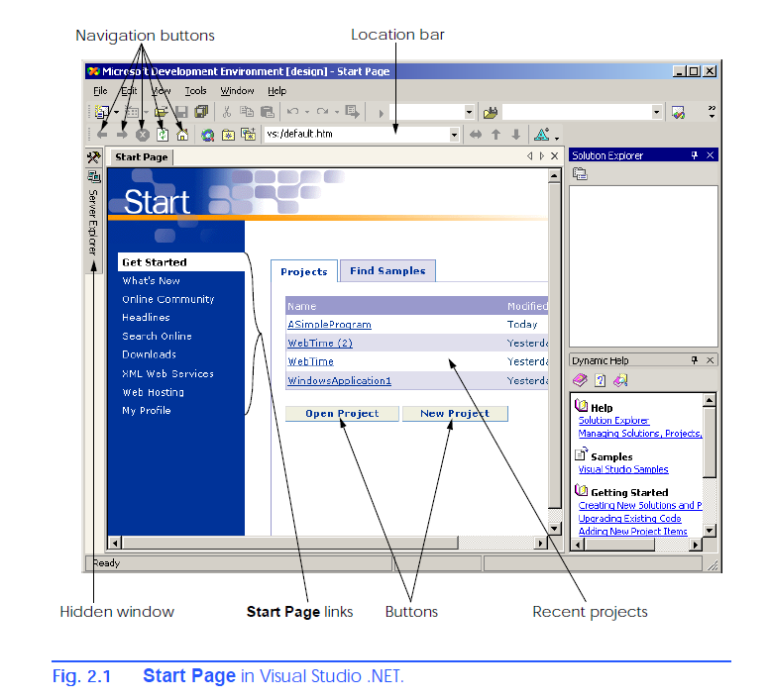
Menubar
Toolbox
Solution
Explorer
Help

Slide 20
Visual Studio .Net IDE ... Start Page
Start Page - Recent Projects, Open Project, New Project, Sample Programs. यह पेज visual studio.net version के अनुसार भिन्न हो सकता है |
What’s New – list of new features and updates
Online Community – group of developers using newgroups (message board on internet) and websites
Headlines – news and articles and how-to guides
Search Online – browse through MSDN (Microsoft Online Developer Netwrok) online library of articles and tutorials and documentation.
Downloads – product updates
XML Web Service – information about web services (reusable pieces of software available on on the internet)
Web Hosting – post your software online for public use. (Deployment)
My Profile – adjust and cutomize various Visual Studio .Net settings
Internal Web Browser - Programmers can browse the internet from within IDE using internal web browser.

Slide 21
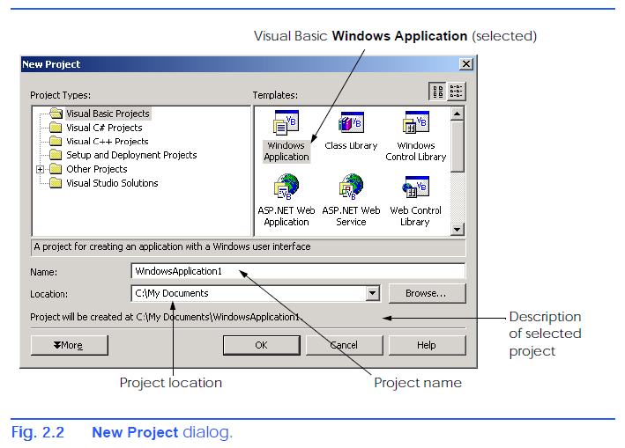
Creating a new Project in IDE -
Click on “New Project” Button on start page.
It will display “New Project Dialog” -
- Visual Studio .Net IDE में programs को project तथा
Solutions में व्यवस्थित रखा जाता है |
- Multiple- project solutions का उपयोग large-scale
Applications बनाने में होता है |
New Projet > Project Type > Template
Project Name – WindowsApplication1
Project Location – C:\My Docuemnts
Click OK button – it will now show design view as shown in next slide.
A Windows Application is a program that executes inside the Windows OS (e.g., Windows 2000 or Windows XP). It has GUI.

Slide 22
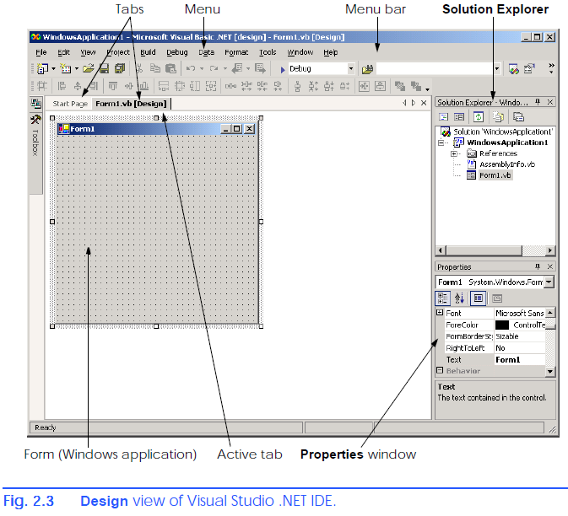
Creating a project – design view
- Form1 – grey rectangle – represents windows
Application.
Form can be customized by adding controls
(reusable components e.g. Buttons etc.
GUI = Form and Controls (visual part of program)
The name of each open document is listed on a tab.
- To view a document, click its tab. Tabs
save space and facilitate easy access to multiple documents.
- Active tab

Slide 23
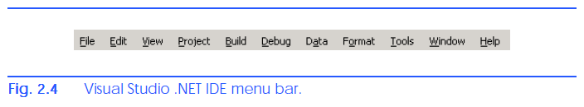
Visual Studio .Net IDE – Menubar & Toolbar
Commands are located on Menubar and related commands (Menu Items) are grouped together in each menu.
File > New > Project
File – Commands for Open Project, closing project, printing peoject etc.
Edit – Cut, Paste, Find, Undo etc.
View – commands to display IDE windows and toolbars.
Project – Commands for managing project and its files.
Build – Commands for compiling a program.
Debug – commands for debugging and running a program.
Data – commands for interacting with databases.
Format – commands for arranging a form’s controls.
Tools – Additional tools and commands for customizing IDE
Windows – commands for arranging and displaying windows.
Help – commands for accessing IDE’s help features.

Slide 24
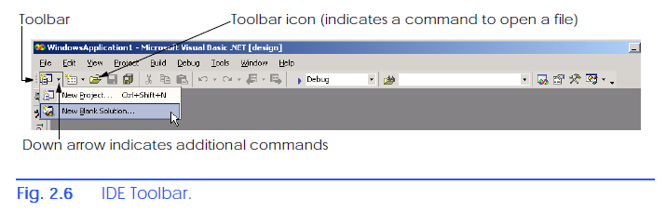
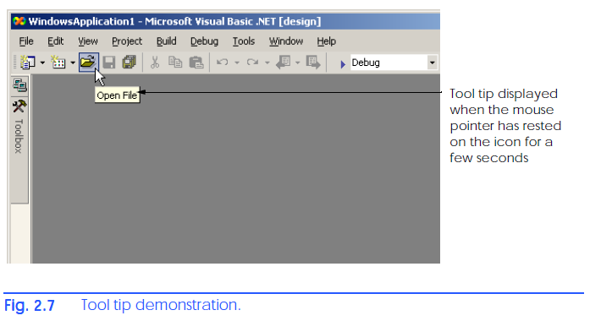
IDE – Toolbars
- Commonly used commands are put on the
Toolbar for quick access.
Toolbar contains pictures called icons that
graphically represent commands.
Click the icon to execute particular command.
Some icon contains down arrow means they contains further commands within it
Tooltip – description about a command shown when user puts mouse over a command’s icon in toolbar.

Slide 25
VB .NET
Object Oriented Programming Language
Implemented on .NET framework
यह calssic VB6 भाषा का विकसित रूप है परन्तु यह VB6 के साथ backward-commpatible नहीं है |
Everything in VB .NET is an object including primitive data types. (Integer, Short, Long, String, Boolean etc.) user defined data types, events, and assemblies.
सारे objects base class Object को inherit करते है |
इसके द्वारा .NET Framework की सम्पूर्ण library को access किया जा सकता है |
Mono – Open Source alternative to .NET

Slide 26
Features of VB .NET – विशेषताएं / गुण
Modern, general purpose.
Object oriented.
Component oriented.
Easy to learn.
Structured language.
It produces efficient programs.
It can be compiled on a variety of computer platforms.
Part of .Net Framework.

Slide 27
Namespaces
Software components (अवयव) जैसे – class, functions, declarations, procedures आदि की logical grouping को namaspace कहते है |
Namesapce = group of software components having specific name
Namspace कंप्यूटर फाइल सिस्टम में folder की तरह है |
इसे namescope भी कहा जाता है |
Identifiers – software component का नाम जिसके द्वारा इसको access किया जाता है |
Namespace का उपयोग naming टकराव को दूर करने के लिए होता है |
दो अलग – अलग namespace में एक ही नाम के identifiers हो सकते है |
किसी object को अपने प्रोग्राम में use करने से पूर्व उसके namesapce को सम्मिलित करना होता है | इसके लिए Imports keyword प्रयुक्त होता है |

Slide 28
Namespace ...
C# or VB.NET में प्रत्येक project एक default Namespace से प्रारंभ होता है जिसका नाम project name ही होता है |
Imports के माध्यम से हम केवल उन्ही classes को access कर सकते है जो की उस Namespace में है जबकि namespace के अन्दर child Namespaces के classes को नहीं |
Namespace reusability प्रदान करते है |
एक class केवल और केवल एक ही namespace से सम्बंधित होगी |
VB.NET में एक ही प्रोग्राम में दो समान नाम की classes नहीं हो सकती है |

Slide 29
Namespace ...
Declaring a namespace –
We can define a Namespace using the "Namespace" keyword. The syntax for declaring a Namespace is:
Namespace <Namespace_name>
// Classes and/or structs and/or enums etc.
End Namespace
All the classes in the .Net Framework belongs to the System Namespace. The "system" Namespace has built-in VB functionality and all other Namespaces are based on this "system" Namespace.
We can access a member of a Namespace by using a dot(.) operator, also known as the period operator.
Nesting a Namespace means create a namespace inside a namespace.
Namespace alias - useful for giving a short name for long namespace. An alias of a namespace is created with the help of the "imports" keyword. Aliasing is useful when we are working with a large project.

Slide 30
Namespace …
Global Keyword – You can use the Global keyword to start the qualification chain at the outermost level of the .NET Framework class library.

Slide 31
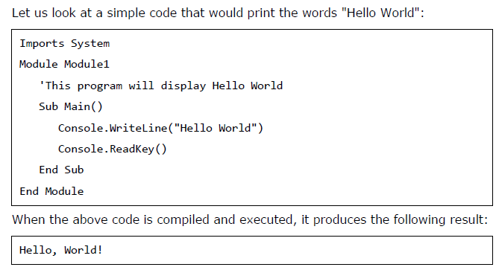
Simple VB .NET program

Slide 32
Program Description -
Imports System - used to include the System namespace.
Module Module1 – Class / Module that will contain one or more functions and data.
Class or module will contain procedure(s). Procedure can be – Sub, Operator, Get, Set, AddHandler, RemoveHandler, RaiseEvent
‘Hello – Comment started with ‘
Main() Procedure

Slide 33
VB. Net Program
VB .Net program को हम objects के collection के रूप में देख सकते है | ये objects एक-दुसरे के साथ communicate करते है | एक object दुसरे object के methods को invoke कर सकते है |
Object – state (value of data members) + behavior (methods)
- instance (अवस्था) of class
Class – data + methods
- template , यह मेमोरी में स्टोर नहीं होता, यह data type की तरह है |
Method – behavior , यह class का member है तथा data को manipulate करता है|
Instant Variables - object’s data at particular time

Slide 34
Class -
Class is used to create objects.
Data members को fields भी कहा जाता है |
Procedure / functions members को methods कहा जाता है |
किसी class के methods को उसके objects से ही call / invoke किया जाता है | परन्तु shared तथा static methods को बिना object के access किया जा सकता है |
Dim r As New Rectangle()

Slide 35
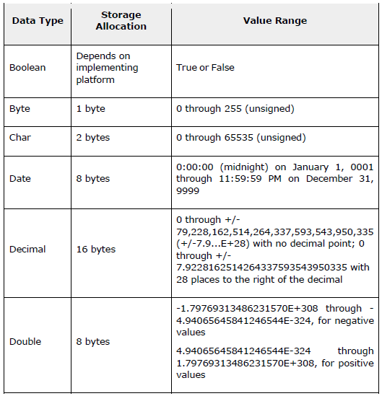
Data Types

Slide 36
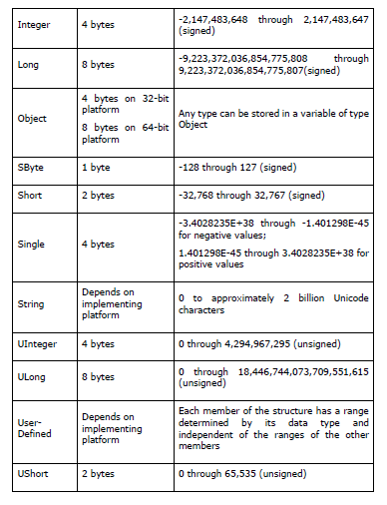

Slide 37
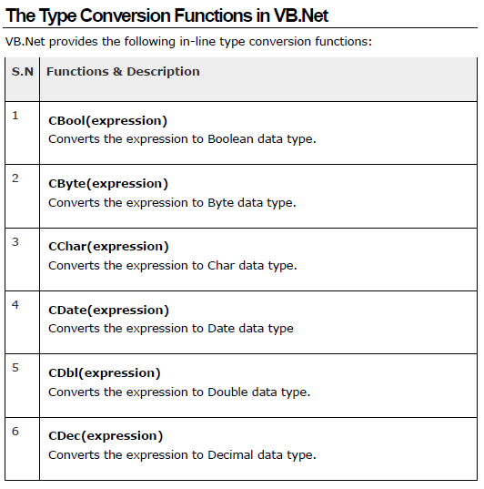
Type conversion functions

Slide 38
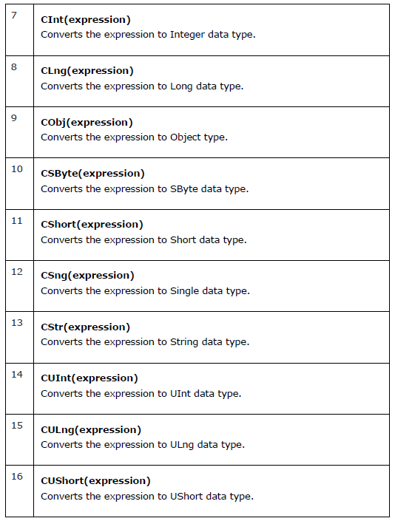

Slide 39
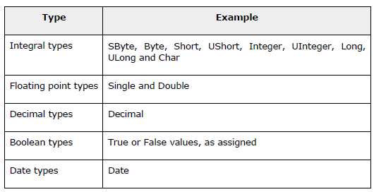
Variable
Variable is a named memory location. Name, type, size and value.
Data Type – size / range of values that can be stored / set of operations

Slide 40
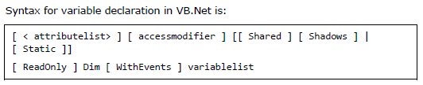
Variable declaration -
Dim statement is used for variable declaration and storage allocation for one or more variable

Slide 41
Variable decalration -
attributeList – List of attributes (Optional)
accessModifier – define the access level. Public, Protected, Friend, Protected Friend, Private. (Optional)
Shared – declares shared variable. Not associated with specific instance of a class.
Shadows – variable redclares and hides identically named element, overloaded elements in base class.
Static – variable will retain its value between function calls.
ReadOnly – variables can be read not written.
withEvents - varaible is used to respond to events raised.
variableList – list of variables declared.
vraiableName – name of varaible
boundList - list of bounds
New – create new instance of a class
dataType -

Slide 42

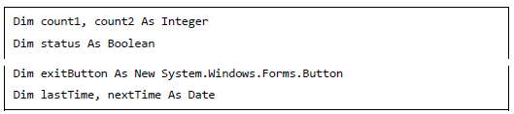
Varaible declaration

Slide 43
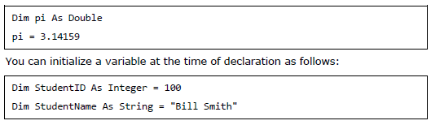
Varaible Initialization

Slide 44
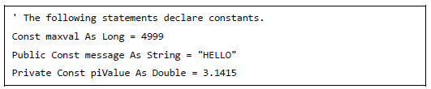
Constants
Constants are fixed values that the program may not alter during its execution.
Enumeration – set of named integer constants.
In VB .net constants are declared using Const statement.

Slide 45
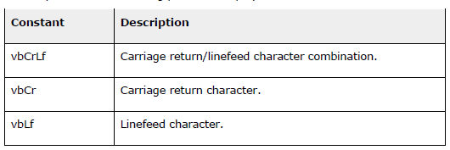
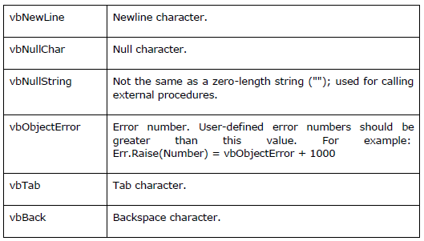
Print and Display Constants in VB .net

Slide 46
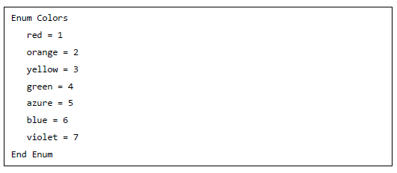
Declaraing enumeration -
Enumeration are declared using Enum statement.

Slide 47
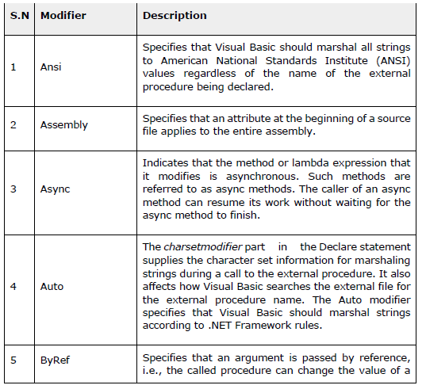
Modifiers -
Keywords which change the behavior of data / functions.

Slide 48
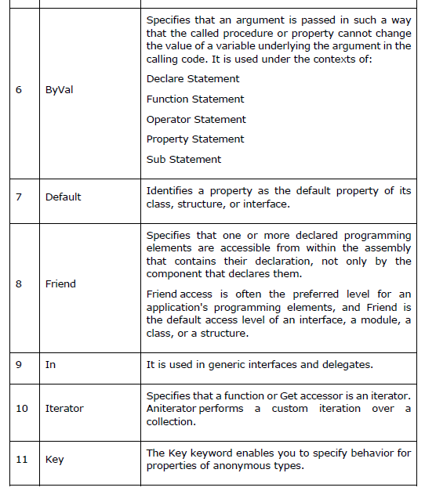

Slide 49
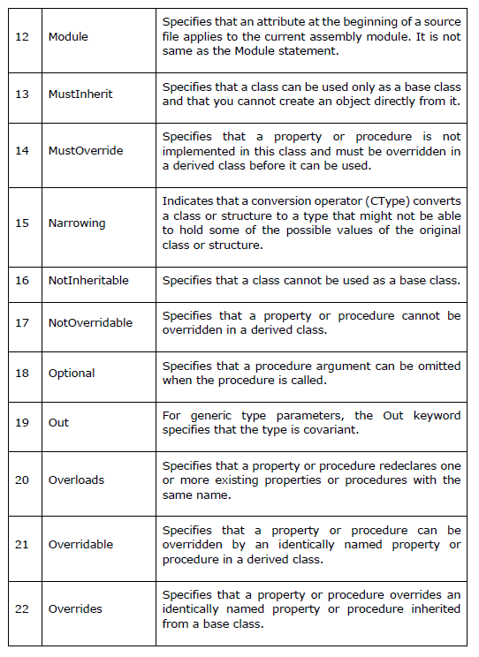

Slide 50
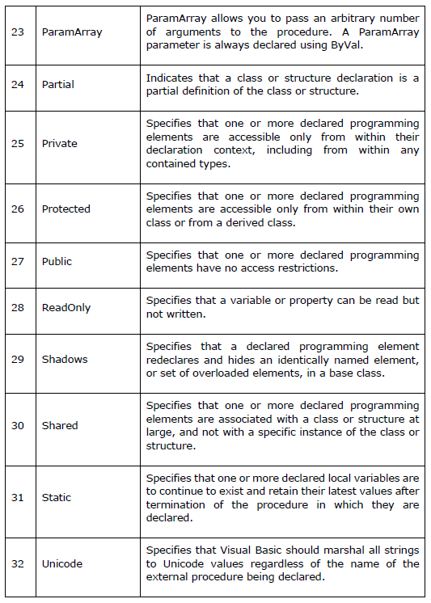

Slide 51
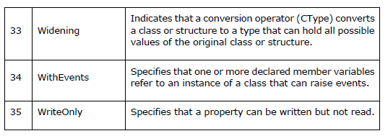

Slide 52
Console Application
Text based application, No GUI
Console window / command window
MS-DOS Prompt / Command Prompt
‘ hello - anything followed by ‘ is a comment

Slide 53
Module
Logical group of procedures.
Console application must have one module and one procedure.
Module keyword is used to define a module.
Visual Basic keywords and identifiers are not case sensitive.
Main – entry point of a program.
Sub
…..
End Sub

Slide 54
Console.WriteLine(“Hello World”)
Dot (.) operator
Class – group of related methods and data
This Visual Studio .NET IDE feature, called IntelliSense,

Slide 55
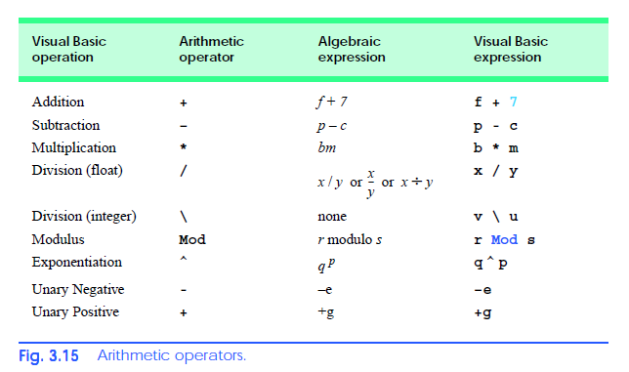

Slide 56
/ Floating point division
\ Integer division = result will be integer Integer \ Integer = Integer
7.1\4 = 1
7.7\4 = 2 (7.7 rounded to 8)
Mod – it gives remainder after Integer division.
7 Mod 4 = 3 17 Mod 5 = 2
Expressions are written in “straight-line form”

Slide 57
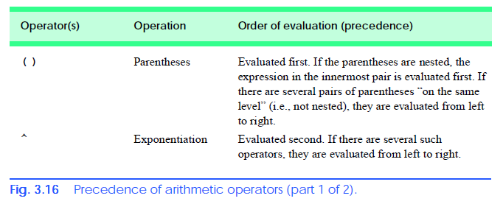

Slide 58
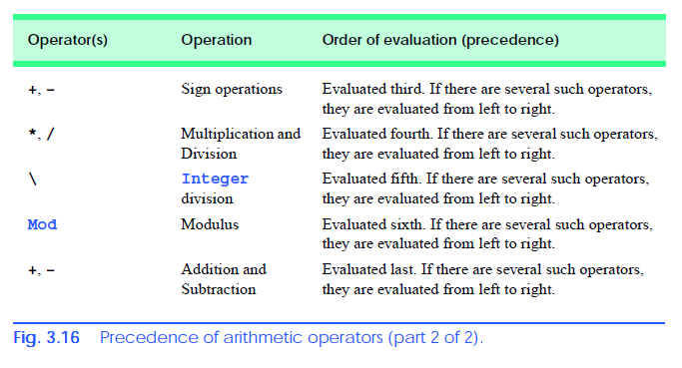

Slide 59
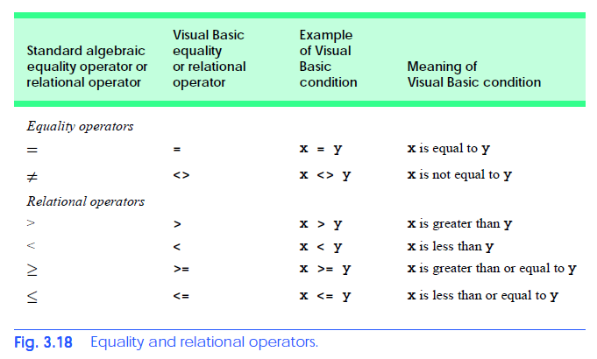

Slide 60
Using Dialog Box to display output -
Dialog Box – windows that display message to the user.
Class MessageBox( ) is used for creating dialogs.
FCL (Framework Class Library) – contains classes that can be used to create GUI.
FCL classes are grouped together into namespaces.
System.Windows.Forms - namespace

Slide 61
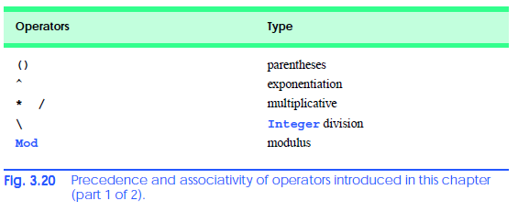
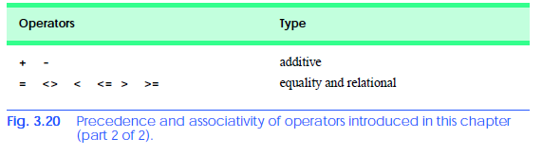

Slide 62
Math.sqrt( )
_ line continuation character : to split long statements over multiple lines
The compiled classes are located in a file, called an assembly, that has a .dll (dynamic link library) extension.
MSDN – MicroSoft Developers Network Documentation

Slide 63
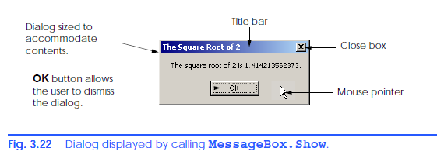


Slide 64
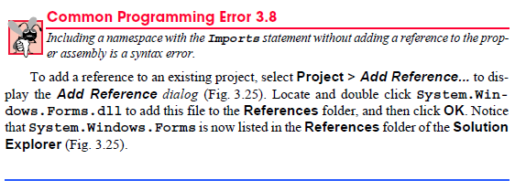
Add reference to dll in Project

Slide 65
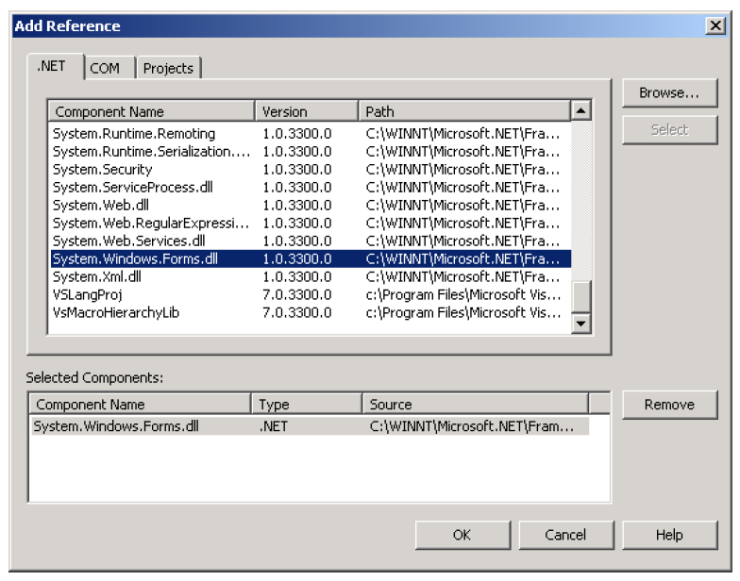

Slide 66
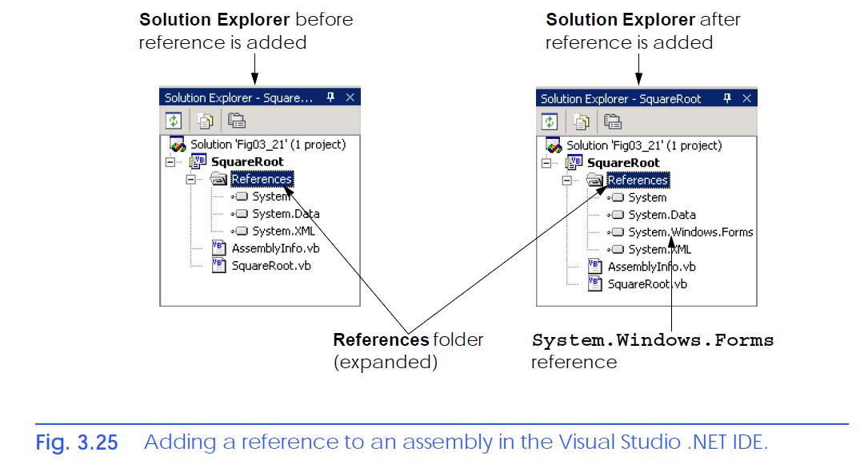

Slide 67
Class Console, for instance, is located in the assembly mscorlib.dll, but we did not need to reference this assembly explicitly to use it.

Slide 68
Control Structures
Algorithm – procedure for solving a particular problem. It tells about the actions to be performed and the order in which actions are to be performed.
Program Control - Task of ordering program statements correctly.
Pseudo Code – informal language that helps programmers develop algorithms. It is similar to every day English.

Slide 69


Slide 70
Sequential Execution
Statements in a program are executed one after another in the order in which they are written.
A transfer of control occurs when an executed statement does not directly follow the previously executed statement in the written program.
GoTo statement – transfer control to particular location
GoTo-less-programming
The key to these successes is that structured programs are clearer, easier to debug and modify and more likely to be bug-free in the first place.

Slide 71
3 Control Structures -
1. Sequence Structure
2. Selection Structure
3. Repetition Structure

Slide 72
Flowchart -
A flowchart is a graphical representation of an algorithm or of a portion of an algorithm. Flowcharts are drawn using certain special-purpose symbols, such as rectangles, diamonds, ovals and small circles. These symbols are connected by arrows called flowlines, which indicate the order in which the actions of the algorithm execute. The order of execution is known as the flow of control.

Slide 73
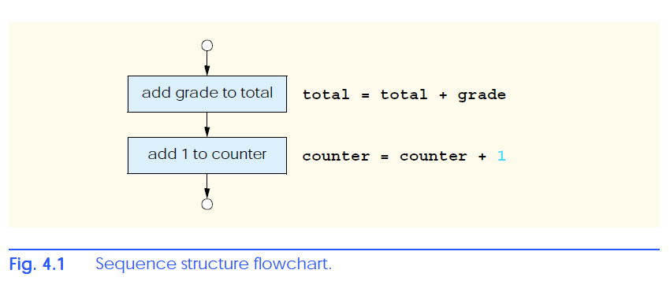
Rectangle Symbol or Action Symbol : represent action
Oval Symbol – Start / End
Circle Symbol – Connector Symbol
Diamond Symbol – Decision Symbol

Slide 74
Selection Structure (3)
If…Then - It performs an action (or series of actions) if a condition is true or skips the action (or series of actions). Single-selection structure
If….Then …. Else - It performs an action (or series of actions) if condition is true and performs different action (or series of actions) if condition is false. Double-selection structure
Select….Case – It performs one of many actions (or series of actions). Multiple Selection Structure

Slide 75
Repetition Structures (7)
While
Do …. While/Loop
Do/Loop…. While
Do ….. Until/Loop
Do/Loop …….. Until
For/Next
For Each/Next

Slide 76
VB has 11 types of control structures.
Sequence (1)
Selection (3)
Repetition (7)

Slide 77
Control Structure Nesting
Placing one control structure in another control structure.
Control Structure Stacking

Slide 78



If….Then Control Structure
Pseudo Code
Statement
Visual Basic Code

Slide 79
Syntax Error – detected at the time of compilation
Logical Error – detected on run-time
1. Fatal Logical Error
2. Non-fatal Logical Error

Slide 80
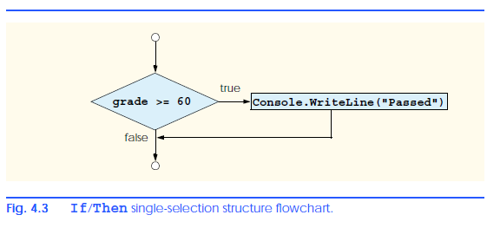

Slide 81


If….Then …. Else Control Structure

Slide 82
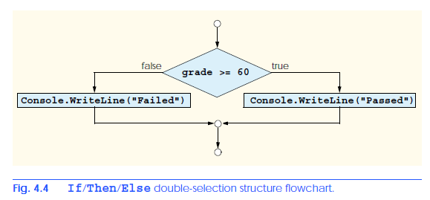

Slide 83
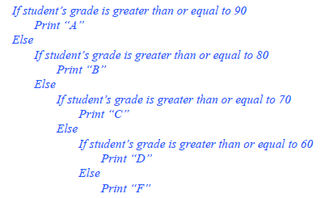
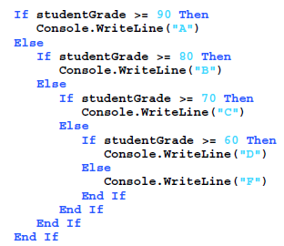

Slide 84
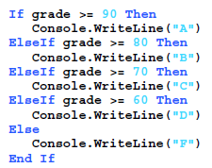
Use of ElseIf Kyword

Slide 85

Repetition Structure
Used to repeat action(s) depending on the condition
Condition can be True / False.
What are the actions in this pseudo code ?
Program – Find first power of two larger than 1000.
2 4 8 16 32 64 128 256 512 1024

Slide 86
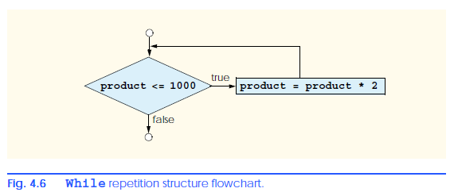

Slide 87
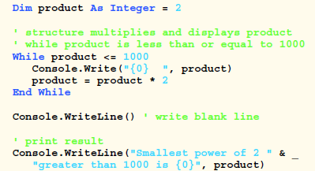
Find first power of 2 greater than 1000.

Slide 88
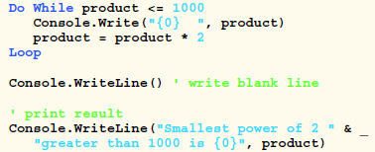
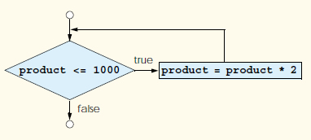
Do/While repetition -
It behaves like While repetition structure.
Find first power of 2 greater than 1000 using Do/While.

Slide 89
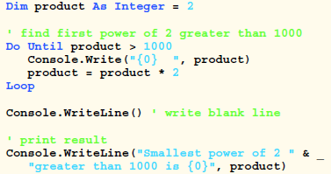
Do Until / Loop Structure
Until – negative condition – जब तक नहीं

Slide 90
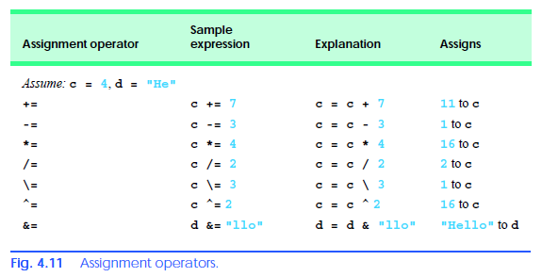
Assignment Operators

Slide 91
Solving a Problem(1) using Computer
Problem Statement
Average = sum of grades / number of students
Counter-controlled repetition to input grades of ten students.
Counter is used to keep track of number of times a set of statements has executed.
Definite repetition = number of repetitions is known in advance.

Slide 92
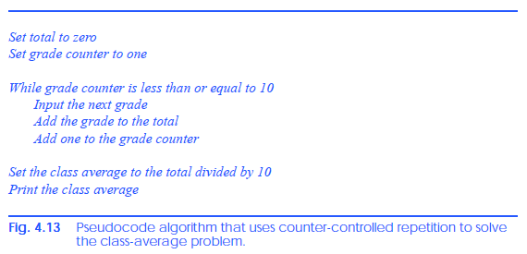
Psuedo Code to solve the problem(1) -

Slide 93
Double – used to store double-precesion floating point number.
Single – used to store Single-precision floating point numbers.

Slide 94
Sentinel-Controlled repetition
Stop repetition when a particular value is entered by user.
e.g. ESC key or Q or -1
Special value called “sentinel value” ( also called signal value / dummy value / flag value ) to indicate end of repetition.
It is also called indefinite repetition because the number of repetitions is not known before the loop begins its execution.

Slide 95
Problem(2)
Number of students not known in advance in this case.
Since grade value is between 0 to 100. So we can use -1 as sentinel value.

Slide 96
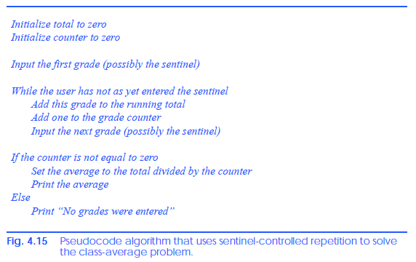

Slide 97
Repetition -
Sentinel Controlled Repetition (number of time to repeat is not known)
Counter Controlled Repetition (number of times to repeat is known in advance)
Counter variable, Initial / Starting value of counter, final value of counter and condition to check for final value of counter

Slide 98

While Structure

Slide 99

To = keyword
Step = keyword
Next = keyword
For = keyword
For/Next Structure

Slide 100

Note - Default Step size = 1 when Step keyword and step size are not
specified

Slide 101

For/Next Structure without step size

Slide 102

MessageBoxIcon Constants

Slide 103

MessageBoxButton Constants

Slide 104

MessageBoxButton Constant ...

Slide 105

Programming Problem

Slide 106
Decimal Data Type
वित्तीय / आर्थिक / पैसों से सम्बंधित गणनाओं में Decimal data type का प्रयोग किया जाता है |
String.Format() - function used to generate formatted strings
vbCrLf = new line character Cr – Carriage Return and Lf = Line Feed
vbTab – Tab character
“{0:C}” - information after : is called Formatting Code
C = Currency (Monetary Format)

Slide 107


Slide 108
Select Case
Select Case grade
Case 5
Console.Write(“You have entered 5”)
Case 10
Console.Write(“You have entered 10”)
Case 20
Console.Write(“You have entered 20”)
Case 50
Console.Write(“You have entered 50”)
Case 100
Console.Write(“You have entered 100”)
Case 200
Console.Write(“You have entered 200”)
Case 500
Console.Write(“You have entered 500”)
Case 1000
Console.Write(“You have entered 1000”)
Case 2000
Console.Write(“You have entered 2000”)
Case Else
Console.Write(“Not a valid currency note”)
End Select
Multiple Selection Structure
Specifying range in case
Case 90 To 99
Case 0, 10 To 59
Note – here range is inclusive
Case Else (it is optional)
Case Is < 0
Note – We can use relational operators in Case
The expression following the keywords Select Case is called the controlling expression.

Slide 109

Do/Loop While - Repetition Structure
यह While तथा Do While / Loop structure की तरह ही कार्य करता है |
While तथा Do While / Loop में condition को Loop के प्रारंभ में check किया जाता है जबकि Do / Loop While में condition को loop body के अंत में check किया जाता है
अतः Do / Loop While की body एक बार तो execute होगी ही होगी |

Slide 110

Do/ Loop While - Flow Chart

Slide 111

Do/Loop Until Repetition Structure
Do / Loop Until तथा Do Until / Loop दोनों एक ही तरह कार्य करते है
Do / Loop Until में condition को Loop के अंत में check किया जाता है | अतः यह कम से कम एक बार तो execute होगा ही होगा |

Slide 112

Do/Loop Until repetition structure flowchart

Slide 113

Exit – Repetition Structure
Exit Do, Exit While, Exit For statements द्वारा Loop को तुरन्त रोका जा सकता है |
Exit एक Keyword है |

Slide 114
ExitTest.vb
Demonstrate the example.

Slide 115
Logical Operators
एक से अधिक conditions को आपस में जोड़ने के लिए logical operators का प्रयोग किया जाता है |
VB .Net में निम्न छः Logical operators होते है -
AndAlso And OrElse Or Xor Not

Slide 116

AndAlso Operator
यह सुनिश्चित करने के लिए की Code तभी संपादित (execute) हो जब दोनों / सभी शर्तें सत्य हो AndAlso का प्रयोग किया जाता है |
दोनों शर्तों को पहले evaluate / check किया जाएगा क्योंकि = तथा >= (relational operators) की प्रधानता (precedence) AndAlso से अधिक होती है
AndAlso द्वारा False शर्त्त (condition) मिलने पर अन्य शर्तों को check नहीं किया जाता है |

Slide 117

Truth Table of AndAlso

Slide 118

OrElse – Operator
यह सुनिश्चित करने के लिए की Code तभी संपादित हो जब दोनों / सभी शर्तों में से कोई भी एक सत्य हो OrElse का प्रयोग किया जाता है |
OrElse द्वारा True शर्त्त (condition) मिलने पर अन्य शर्तों को check नहीं किया जाता है |

Slide 119

Truth table of OrElse
Note : The AndAlso operator has a higher precedence than the OrElse operator.

Slide 120

Xor – Operator
Xor – exclusive OR
यह सुनिश्चित करने के लिए की Code तभी संपादित हो जब दोनों शर्तों में से एक सत्य तथा दूसरी असत्य हो Xor का प्रयोग किया जाता है

Slide 121

Not - Operator
Used for Negation
Used to reverse a condition
यह सत्य (True) को असत्य (False) तथा असत्य को सत्य में बदलने में प्रयुक्त होता है |

Slide 122
And , Or are same as AndAlso , OrElse
No short-circuit evaluation, all conditions are checked when using And , Or

Slide 123


Operator Precedence

Slide 124
Procedures
किसी बड़े प्रोग्राम को विकसित करने तथा उसके रखरखाव का सबसे अच्छा तरीका है की उसको छोटे टुकड़ों में बांटकर बनाया जाये |
इस तकनीक को divide and conquer कहा जाता है | बड़े प्रोग्राम को छोटे टुकड़ों में बांटकर बनाना |

Slide 125
Procedures ...
VB Program = Modules + Classes + Procedures
Framework Class Library (FCL) – built-in classes in .Net Framework, collection of classes and methods for performing common tasks (mathematical calculations, string manipulations, character manipulations, I/O operations, error checking, file handling etc.) e.g. Console class for I/O operations.

Slide 126


Slide 127
Procedures ...
Programmer defined procedures - प्रोग्रामर द्वारा निर्मित procedures
Three types of procedures -
1. Sub Procedures
2. Function Procedures
3. event procedures
Note – Procedure – group of instructions to perform specific task.
Procedure को एक ही बार लिखा जाता है (defined once), परन्तु इसको प्रोग्राम में कई बार execute किया जा सकता है |

Slide 128
Procedure …
Procedure Invocation – procedure को call करना
Procedure को नाम द्वारा इसे आवश्यक parameters / arguments देकर call किया जाता है |
Caller – call करने वाला function / procedure
Callee – procedure जिसे call किया गया है
Task पूर्ण होने पर procedure पुनः लौट जाता है जहाँ से call हुआ था वहां |
Procedure कोई value return कर सकता है |

Slide 129
Code को procedures में divide क्यों करें ?
Small piece of code को बनाना तथा manage करना आसान होता है
Reusable - इसको पुनः प्रयोग में लाया जा सकता है |
एक ही code को बार बार नहीं लिखना पड़ता है |
(avoid repetition of same code)
Small code को debug करना आसान होता है |

Slide 130
Modularity -
Re-usability -
Design
Implementation
Maintenance
Testing

Slide 131

Sub Procedures
अभी तक जो program बनाये उनमें एक procedure अवश्य है - Main( )
Console.WriteLine( ) - FCL method
Sub procedure के प्रारंभ में Sub कीवर्ड तथा अंत में End Sub Keyword का प्रयोग होता है
A procedure is called by another procedure.
Procedure definition - code of the procedure
Note – Demonstrate Payment.vb here, Main( ) procedure calls PrintPay( ) procedure.

Slide 132
Procedure को class अथवा module के बाहर define नहिं कर सकते है यह syntax error है |
Procedure name – valid identifier
Parameter list – comma separated
ByVal – keyword which means calling function must pass value for parameter
Procedure Body / Block – code inside a procedure
A block is a sequence of statements and declarations grouped
together

Slide 133
एक procedure को दुसरे procedure के अन्दर define नहीं किया जा सकता है, यह एक syntax error है |
अर्थात procedure की nesting संभव नहीं है |
Return तथा Exit Sub के द्वारा procedure को रोका जा सकता है |

Slide 134


Slide 135


Slide 136

Function Procedure
Function procedure और Sub procedure दोनों एक ही जैसे है | इनमें केवल एक अंतर है कि Function procedure किसी value को return करता है जबकि Sub procedure कोई value return नहीं करता है |
return-type: data type of value returned by the procedure

Slide 137
Function Procedure
Return expression :
यह statement function procedure में कहीं भी हो सकता है | इसका उपयोग function द्वारा value return करने में होता है |
Function केवल एक ही value return करता है |
Return होने पर control पुनः caller procedure में उसी स्थान पर जाता है जहाँ से यह procedure call हुआ था |
Note - Demonstrate SquareInteger.vb here to show example of function procedure.

Slide 138
Methods
Method – a procedure within a class
- class के भीतर स्थित procedure
GUI Event Handling – ability to respond to state change in GUI
e.g. clicking a button
We create GUI components visually using Toolbox
Change property of a component using Property Window.
FrmMaximum Inherits from System.Windows.Forms.Form

Slide 139
When the user double-clicks a component, such as a Button, in Design mode, the IDE generates a method that Handles an event (i.e., an event handler).
Event handler – method जो किसी event को handle करने में प्रयुक्त होता है | यह तब execute / call होता है जब उससे सम्बंधित event raised (घटित) होती है | Event – User Action
Math.max( ) - function that returns maximum of two numbers
. (dot) - member access operator

Slide 140
Parameter Info Feature – Visual Studio में procedure name type करने में parameter list स्वतः दिखाया जाता है जिससे programmer को मदद मिलती है | इसे parameter info feature कहा जाता है |
IntelliSense Feature – Visual Studio में Class name के बाद . (dot) लगाने पर उसमें उपलब्ध सभी methods को इसके द्वारा list किया जाता है | इस feature को IntelliSense कहा जाता है |

Slide 141
Math Class in VB .Net
Math class – for mathematical calculations
The variables x and y are Doubles.
Math class defines two constants – Math.PI and Math.E
Math.PI = 3.14159265358979323846
Math.E = 2.7182818284590452354

Slide 142
Math class methods
Abs(x) - returns absolute value (परिमाण) of x
Abs(23.7) 23.7
Abs(0) 0
Abs(-23.7) 23.7
Ceiling(x) - returns smallest integer not less than x
Ceiling(9.2) → 10.0
Ceiling(-9.8) → -9.0

Slide 143
Cos(x) – returns cosine of x ( x is in radians)
Cos(0.0) → 1
Exp(x) - returns exponential of x
Exp(1.0) - 2.71828182845905
Floor(x) – returns integer not greater than x
Floor(9.2) → 9.0
Floor(-9.8) → -10.0

Slide 144
Log(x) returns the natural logarithm of x (base e)
Max(x, y) returns the larger value of x and y (also has versions for Single, Integer and Long values)
Min(x, y) returns the smaller value of x and y (also has versions for Single, Integer and Long values)
Pow(x, y) calculates x raised to power y (x^y)
Sin(x) returns the trigonometric sine of x (x in radians)

Slide 145
Sqrt(x) returns the square root of x
Tan(x) returns the trigonometric tangent of x (x in radians)

Slide 146
Promotion of arguments
Procedure call के समय arguments का data type स्वतः आवश्यकतानुसार उचित रूप में बदल जाता है | यही promotion of arguments है |
Coercion of arguments – forcing arguments to the appropriate data type so that they can be passed to a procedure.
Two types of conversion – widening conversion (no data loss) and narrowing conversion (there may be data loss)

Slide 147


Slide 148
Change data type explicitly
Convert class methods are used for changing data types
explicitly
e.g. number = Convert.ToInt32(Consol.ReadLine())
Int32 = 32 bit Integer
Solution Explorer → Common Properties → Option Strict → Default set Off
Option Explicit

Slide 149
Passing argument to procedure
1. Pass by value (call-by-value)
2. Pass by reference (call-by-reference)
Data Types can be of two types -
Value Types and Reference Types
Reference type variable में memory location को संग्रहीत किया जाता है जहाँ data store किया जाएगा | e.g. String, Object
Value type variable में एक single value संग्रहित होती है | e.g. Integer, Double etc.
Strong Typing – Option Explicit = On

Slide 150

Primitive Data Types

Slide 151

Primitive Data Types

Slide 152


Literals
Values जिन्हें प्रोग्राम में सीधे type किया गया है उन्हें literals कहा जाता है |
Dim character As Char = "Z"c

Slide 153
Pass-by-value (call-by-value)
जब arguments को by value pass किया जाता है तो program द्वारा इसकी एक copy बनाई जाती है तथा copy को called procedure को भेजा जाता है |
जब called procedure के अन्दर arguments की value change होती है तो calling procedure में भेजे गए arguments में कोई परिवर्तन नहीं होता है |
इसके लिए ByVal Keyword का प्रयोग होता है |

Slide 154
Pass by reference (call-by-reference)
इसमें procedure call के दौरान arguments में variable का address (memory location) भेजी जाती है |
अतः यदि called procedure द्वारा variable की value परिवर्तित की जाती है तो calling procedure के variables में भी परिवर्तन होता है
इसके लिए ByRef keyword का प्रयोग होता है |
Pass-by-reference security को कमजोर करता है क्यूंकि called procedure डाटा को
परिवर्तित कर सकता है |

Slide 155
Note -
यदि procedure call में argument को ( ) में भेजा जाता है तो argument variable के value की copy ही जाती है न की reference (address), चाहे procedure header में ByRef keyword का प्रयोग हुआ हो |
Demonstrate ByRefTest.vb here

Slide 156
Duration / Lifetime of identifiers (variables)
Identifier – name of variable / procedure / module / class
Identifier के दो attributes होते है - duration and scope
Lifetime / Duration = समय या अवधि जब तक एक identifier memory में अस्तित्व रखता है |
Scope – किसी प्रोग्राम का portion जिसमें identifier को accessible किया जा सकता है |

Slide 157
Scopes
Class scope
Module Scope
Namespace Scope
Block Scope
Class ………….. End Class
Local variable

Slide 158
MessageBox( )
PictureBox( )
GroupBox( )

Slide 159
Recursive Procedure
Procedure जो स्वयं को call करता है उसे recursive procedure कहा जाता है |
Factorial Program using recursion
Fibonacci Series using Recursion

Slide 160
Procedure Overloading
Overloading के द्वारा एक ही नाम से कई procedure हो सकते है परन्तु इसमें arguments की संख्या या type भिन्न होना आवश्यक है | Overloaded procedure का signature भिन्न होता है |
Signature = Procedure name and parameter types
Optional Arguments - इन्हें procedure call में pass करना आवश्यक नहीं होता है | ऐसी स्थिति में इनकी default value प्रयुक्त होती है |

Slide 161
Overload Resolution – प्रक्रिया (process) जिसके द्वारा compiler यह तय करता है की कौनसे overloaded procedure को call किया जाना है |
Optional arguments – इन्हें procedure में Optional Keyword की सहायता से दर्शाया जाता है |

Slide 162


Slide 163
Module
Programmers द्वारा Module का प्रयोग कई सम्बंधित procedures को एक साथ group करने में होता है | ताकि इन्हें दुसरे programs में re-use किया जा सके |
Note: New modules are added to a project by selecting Project > Add Module.
To include a module in a project, select File > Add Existing Item…. In the dialog that is displayed, select the module file name and click Open.
Although it is not necessary, the programmer may place the file containing the module’s code in the same directory as the other files for the project.

Slide 164
Arrays

Slide 165
Arrays
Array एक प्रकार का data structure है |
Array = group data items of same data type
Array are static, it means their size remains same once defined.
Array is group of contiguous memory locations.

Slide 166


Slide 167

All arrays have access to the methods and properties of class System.Array, including the Length property.

Slide 168
Declaring an array
To declare an array, the programmer provides the array’s name and data type. The following statement declares the array
Dim numberArray As Integer()
The parentheses that follow the data type indicate that numberArray is an array.
Before the array can be used, the programmer must specify the size of the array and allocate memory for the array, using keyword New
The value stored in the array variable is actually a reference to the location in the computer’s memory where the array object is created.
All non primitive-type variables are reference variables (normally called references).

Slide 169
To allocate memory for the array numberArray after it has been declared, the statement numberArray = New Integer(11) {}
The required braces ({ and }) are called an initializer list and specify the initial values of the elements in the array.
When the initializer list is empty, the elements in the array are initialized to the default value for the data type of the elements of the array. The default value is 0 for numeric primitive data-type variables, False for Boolean variables and Nothing for references.
Keyword Nothing denotes an empty reference (i.e., a value indicating that a reference variable has not been assigned an address in the computer’s memory).

Slide 170

Demonstrate CreateArray.vb

Slide 171
Initialize the values in Array
InitArray.vb
SumArray.vb

Slide 172

Passing arrays to procedures

Slide 173
Is operator – used to compare two references to check if they are pointing / referencing to same object.
ArrayReferenceTest.vb

Slide 174
Multidimensional Rectangular Array and Jagged Array
One-dimensional Array – single sub-scripted array
array with one row of values.
Multi-dimensional Array – multi- sub scripted array
Array with multiple rows of values
two or more indices to access array element
Array of arrays

Slide 175

Two dimensional array
Double- sub scripted array
Array with multiple rows of values

Slide 176

Types of multi-dimensional array
1. Rectangular Array - with rows and columns
- each row has equal number of columns
2. Jagged Array – with rows and columns
- each row may have unequal number of columns
A (i, j) - where i= row and j = column

Slide 177


Slide 178

Multi-dimensional array declaration and initialization

Slide 179

Jagged arrays are maintained as arrays of arrays. Unlike rectangular arrays, rows in
jagged arrays can be of different lengths.
Demonstrate MultiDimensionasArray.vb here

Slide 180
Variable number of parameters to procedure
ऐसा procedure बनाना संभव है जिसमें arguments की संख्या निश्चित न हो बल्कि variable हो |
इसके लिए ParamArray keyword का प्रयोग किया जाता है |
Procedure को pass किये जाने वाले arguments को एक ऐरे में संग्रहित किया जाता है |

Slide 181

For Each / Next
Used for iterating through data structures such as array.

Slide 182
Object Based Programming
Using VB .Net

Slide 183
Class = Variables (data) + methods (behaviors)
Encapsulation – combining data and methods together
Information hiding – One object hides its implementation information from other objects.
Object – instance of a class
Class is a user-defined-type
Abstract Data Type – hide its implementation information

Slide 184
Project → Add Class
Inherits – keyword used to inherit existing class
Class
………….
………
End Class
Public and Private – access specifiers
Private methods are called utility methods / helper methods. They can only be called by other methods but not directly.
Access methods – can read and display data

Slide 185
Constructor – New( )
New( ) - is a constructor method
There can be more than one constructor methods with different number of parameters.
It is a special method that initializes an object’s instance variables.
Constructors can take arguments but cannot return values.
Constructors are implemented as Sub procedure.
Constructors are public methods of a class.

Slide 186
"{0}:{1:D2}:{2:D2}" - D2 means base 10 decimal format with two digit
After defining the class, we can use it as a type in declarations such as
Dim sunset As CTime ' reference to object of type CTime
Class CTime = Type
एक Class से कई objects निर्मित किये जा सकते है |
प्रोग्रामर अपनी आवश्यकता अनुसार नए Class Type बना सकते है| इसी कारण VB को Extensible Language कहा जाता है |
Keyword New का प्रयोग object को मेमोरी allocate करने में होता है |
Imports keyword का प्रयोग namesapce को import करने के लिए होता है |

Slide 187
यदि class तथा प्रोग्राम दोनों एक ही namesapce में है तो Imports करने की आवश्यकता नहीं होती है |
VB में प्रत्येक class किसी namespace का हिस्सा होती है | यदि class का namespace नहीं दर्शाया गया है तो इसे default namespace में रखा जाता है जो की current directory होता है |

Slide 188
Non-application class – class जिसमें Main( ) method नहीं होता है
Application हमेशा Main( ) method से प्रारंभ होता है |
सिर्फ public operations को बाहर से access किया जा सकता है |
Class में member के रूप में दुसरे class का reference हो सकता है

Slide 189
Class scope
Class members को केवल उस class के methods के द्वारा access किया जा सकता है |
Class के member variables तथा methods का scope केवल class तक ही सीमित होता है | अर्थात class scope होता है |
Class members जो visible (Public) है उन्हें handle (object reference) द्वारा access किया जा सकता है |
Block scope - इसका दायरा केवल function / method / control structure तक ही सीमित होता है |

Slide 190
Me Keyword
यदि Class के किसी method में स्थित variable और Class के member variable का नाम एक ही हो तब इस स्थिति में यदि हम method में उस variable को access करते है तो यह उस method के local variable को व्यक्त करता है | यदि हमें method के भीतर Class के member variable को access करना है तो Me.<variable name> का प्रयोग किया जाता है |

Slide 191
Access Specifiers
Access specifiers are used to specify access control for a variable and method.
Public members are accessible outside the class.
Private members are accessible only inside a class not outside the class.

Slide 193
References
https://www.tutorialspoint.com/net_framework_online_training/net_framework_introduction.asp
https://www.c-sharpcorner.com/ebooks/

